Slide 1
C21 Biotechnology
Using living organisms to carry out processes that make substances we want.
IGCSE Biology
Wendy Chai

Slide 2
Contents
Using microorganisms: Food: Bread, Brewing, Yoghurt; Penicillin; Biofuel;
Make use of enzymes: biological washing powder, fruit juice, lactose-free milk
Genetic engineering

Slide 3
Using microorganisms
Why bacteria are useful in biotechnology and genetic engineering?
rapid reproduction rate, easy to grow in laboratory
ability to make complex molecules
lack of ethical concerns over their manipulation and growth
genetic code shared with all other organisms
presence of plasmids

Slide 4
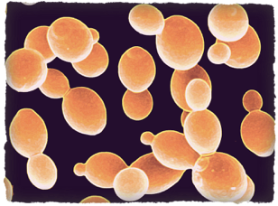
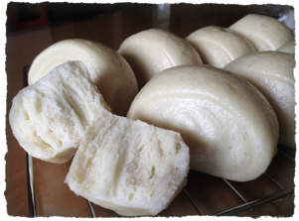

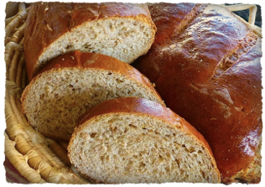
Yeast
Yeast is a fungus, eukaryotic, single-celled organism.
At least 1,500 species are currently recognized.
Can do aerobic and anaerobic respiration
Baking bread
Brewing (alcoholic beverages)
✓
C6H12O6 C2H5OH + CO2
Notes:
Most yeasts reproduce asexually by mitosis, and many do so by the asymmetric division process known as budding. With their single-celled growth habit, yeasts can be contrasted with molds, which grow hyphae.

Slide 5
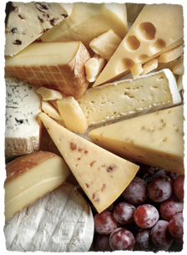

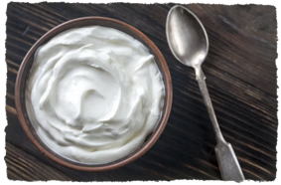
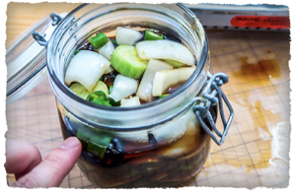
Fermentation
Fermentation is a metabolic process that produces chemical changes in organic substrates through the action of enzymes.
Fermentation in food processing:
converting carbohydrates to alcohol or organic acids (such as lactic acid)
using microorganisms—yeasts or bacteria
under anaerobic conditions.
e.g. produce alcohol, bread and yogurt.
Other widely consumed fermented foods include vinegar, olives, soy sauce, pickles and cheese, etc.
Notes:
If oxygen is present in the cell, many organisms will bypass fermentation and undergo cellular respiration; however, facultative anaerobic organisms will both ferment and undergo respiration in the presence of oxygen.
Fermentation is a metabolic process that produces chemical changes in organic substrates through the action of enzymes. In biochemistry, it is narrowly defined as the extraction of energy from carbohydrates in the absence of respiration. In the context of food production, it may more broadly refer to any process in which the activity of microorganisms brings about a desirable change to a foodstuff or beverage. The science of fermentation is known as zymology.

Slide 6

Yogurt
The main method of producing yogurt is through the lactic acid fermentation of milk with harmless bacteria.
The primary bacteria used are typically Lactobacillus bulgaricus (保加利亚乳杆菌) and Streptococcus thermophilus (嗜热链球菌), and United States as well as European law requires all yogurts to contain these two cultures (though others may be added as probiotic cultures).
These bacteria produce lactic acid in the milk culture, decreasing its pH and causing it to congeal.
The bacteria also produce compounds that give yogurt its distinctive flavor.
An additional effect of the lowered pH is the incompatibility of the acidic environment with many other types of harmful bacteria.
Notes:
Probiotics are live microorganisms that are intended to have health benefits when consumed or applied to the body. Many of the microorganisms in probiotic products are the same as or similar to microorganisms that naturally live in our bodies.

Slide 7
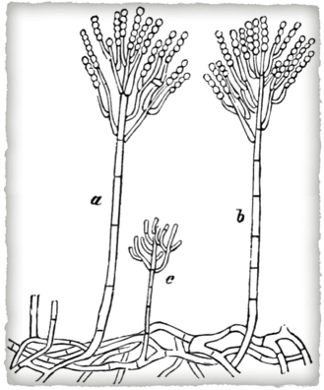
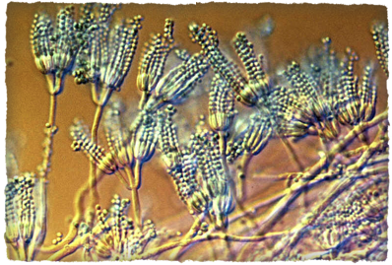
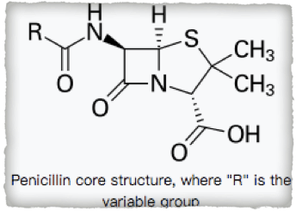
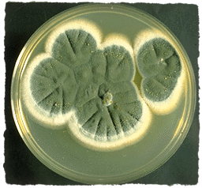
Penicillin
Penicillin antibiotics were among the first medications to be effective against many bacterial infections caused by staphylococci (葡萄状球菌) and streptococci (链球菌).
Produced by Penicillium moulds, a fungus that grows hyphae.

Slide 8
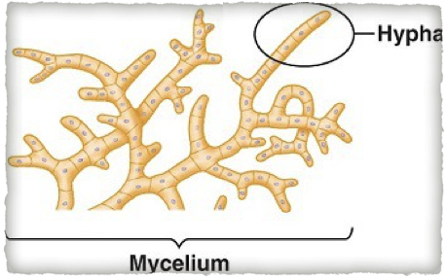
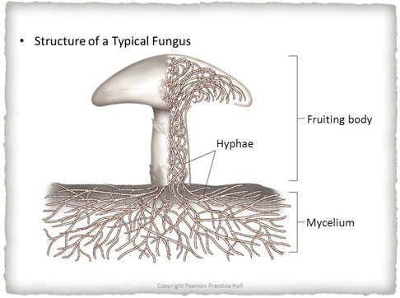
Hyphae, thread-like filaments/ chains of cells that form mycelium of a fungus.
Mycelium, interwoven mass of hyphae.
Fruiting body, is the reproductive structure, bearing spores.
(Wikipedia) Mycelium is the vegetative part of a fungus or fungus-like bacterial colony, consisting of a mass of branching, thread-like hyphae.

Slide 9
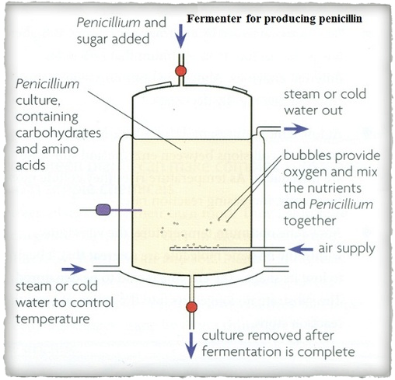
Fermenter
Nutrients such as carbohydrates and amino acids
Oxygen: in sterilised air
Suitable temperature: steam or cold water
Probes to detect pH and temperature
Stirrer

Slide 10
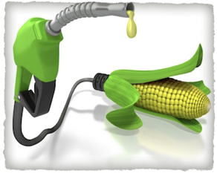
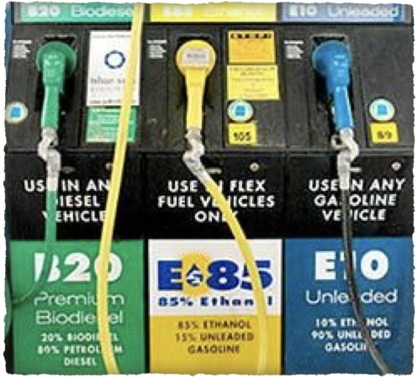
Biofuel
Biofuels are produced from biomass.
Ethanol from corn and sugarcane, and biodiesel from soy, rapeseed, and oil palm dominate the current market for biofuels.
Advanced second-generation biofuels are made from non-food (cellulosic and algae-based) feedstocks, such as municipal waste, algae, perennial grasses, and wood chips.
Notes:
Biomass is biological material derived from living, or recently living organisms. As an energy source, biomass can either be burned to produce heat and to generate electricity or converted to modern biofuels such as biodiesel and ethanol.
In the United States, corn-based ethanol has replaced less than 10% of motor gasoline use since 2011, but has consumed around 40% of the annual corn harvest in the country.
In Malaysia and Indonesia, the clearing of forests to produce palm oil for biodiesel has led to serious social and environmental effects, as these forests are critical carbon sinks and habitats for endangered species.When it comes to the potential to produce fuel, no feedstock can match algae In terms of quantity or diversity. The diversity of fuel that algae can produce results from two characteristics of the microorganism. First, algae produce an oil that can easily be refined into diesel or even certain components of gasoline. More importantly, however, is a second property in it can be genetically manipulated to produce everything from ethanol and butanol to even gasoline and diesel fuel directly.
Diversity is not the only thing that algae has going for it in terms of fuel potential. It is also capable of producing outstanding yields. In fact, algae have been used to produce up to 9000 gallons of biofuel per acre, which is 10-fold what the best traditional feedstock have been able to generate.

Slide 11
Biofuel
http://biofuel.org.uk/what-are-biofuels.html
gasoline-ethanol blend
E10 (10% ethanol, 90% gasoline)
E85 (51%–83% ethanol
Like petroleum-derived diesel, biodiesel is used to fuel compression-ignition (diesel) engines.
Biodiesel can be blended with petroleum diesel in any percentage, including B100 (pure biodiesel) and, the most common blend, B20 (a blend containing 20% biodiesel and 80% petroleum diesel).
The common method for converting biomass into ethanol is called fermentation.
During fermentation, microorganisms (e.g., bacteria and yeast) metabolize plant sugars and produce ethanol.
Notes:
Biodiesel is a liquid fuel produced from renewable sources, such as new and used vegetable oils and animal fats and is a cleaner-burning replacement for petroleum-based diesel fuel.
Ethanol is often used as a biofuel. In most countries, it is mixed with gasoline to create a blend that is sometimes referred to as gasahol. In the United States, the mixture is usually 10 percent ethanol and 90 percent gasoline. This is referred to as E10 and it can be used in any car that burns gasoline. Some cars are known as flexible fuel vehicles or flex fuel for short. These cars can use gasoline that contains as much as 80 percent ethanol. In Brazil, some cars can run on 100 percent ethanol, which is widely available in that country thanks to its abundant supply of sugar cane.

Slide 12
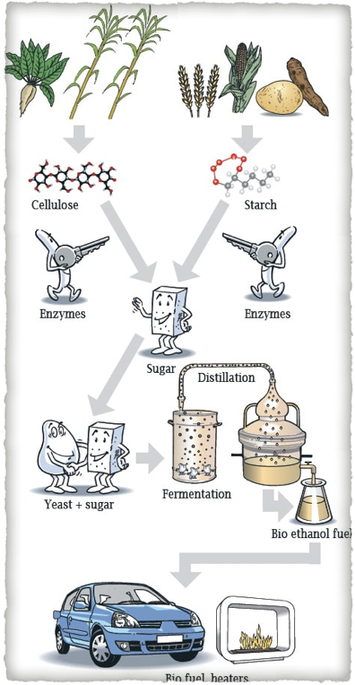
Biofuel
The method used for producing ethanol is different than the method used for producing a biodiesel.
Ethanol: plants + amylase, add yeast (or bacteria)
biodiesel = vegetable oils like canola, corn, and sunflower oil or algae + methanol/ ethanol + lye catalyst like NaOH
Notes:
These fuels include cellulosic ethanol, bio-butanol, methanol and a number of synthetic gasoline/diesel equivalents.

Slide 13
Energy Content of Biofuels
The energy content of biodiesel is about 90% that of petroleum diesel.
The energy content of ethanol is about 50% that of gasoline.
The energy content of butanol is about 80% that of gasoline.
Most biofuels are at least as energy dense as coal, but produce less carbon dioxide when burned.
The lower energy content of biofuels means vehicles travel shorter distances on the same amount of fuel. This has to be taken into account when considering emissions.
Fun facts
Biodiesel is sulfur free, but contains nitrates that contribute to acid rain.
Most gasoline and diesel fuels in North America and Europe are blended with biofuel.
The U.S. and Brazil produce 87% of the world's fuel ethanol.
Ethanol is added to gasoline to improve octane and reduce emissions.
Biodiesel is added to petroleum-based diesel to reduce emissions and improve engine life.

Slide 14
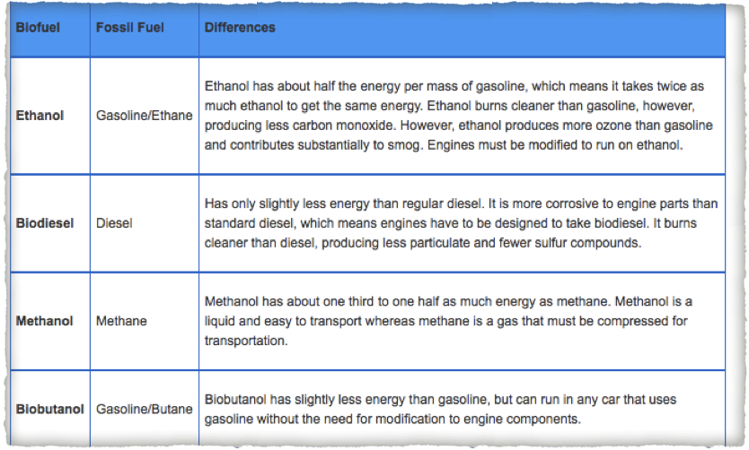
Biofuel
The table compares various biofuels with their fossil fuel counterparts.
Notes:
Petroleum is a rather simple substance because almost all of the molecules are hydrocarbons. Though come in varying lengths and some are gases, others are liquid, and still others are solids, the fact that they are all made of hydrogen and carbon means that they all behave in roughly the same way. The same is not true of biofuel.
Biofuels contain oxygen. By adding just that one atom, the complexity of these molecules begins to rise dramatically. Whereas the major difference between fossil fuels revolves around whether they have single or double bonds and how long they are, the differences between biofuels are far more complex. Because of the oxygen, biofuels can contain alcohols, esters, ethers, and acid groups. Each of these groups is a whole subset of organic chemistry and each has special reaction characteristics. Alcohols are really nothing like ester, which are not like acids at all. The net result of adding oxygen is a huge jump in complexity.

Slide 15
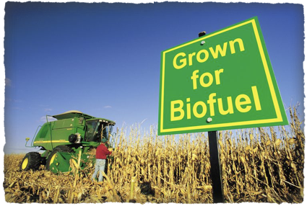
Biofuel
Cons:
Growing corn for ethanol involves large amounts of synthetic fertilizer and herbicide.
The huge amount of land it takes away from food production and natural ecosystems. This may rise price of food.
Biofuels aren't meant for all vehicles, especially older ones.
Pros:
Clean energy, less pollution. As technology progresses, bioenergy has the potential to dramatically reduce greenhouse emissions, the release of harmful gases associated with global warming and climate change.
Notes:
Bioenergy is renewable energy made available from materials derived from biological sources.
Most bioenergy comes from forests, agricultural farms, and waste. The feedstocks are grown by farms specifically for their use as an energy source. Common crops include starch or sugar-based plants, like sugarcane or corn.
Biomass is any organic material which has stored sunlight in the form of chemical energy.
In its most narrow sense bioenergy is a synonym to biofuel, which is fuel derived from biological sources. In its broader sense it (bioenergy) includes biomass, the biological material used as a biofuel, as well as the social, economic, scientific and technical fields associated with using biological sources for energy.
Biomass is the material derived from recently living organisms, which includes plants, animals and their byproducts.[6] Manure, garden waste and crop residues are all sources of biomass.
At this time, bioenergy is not ready to replace fossil fuels. The process is too costly and uses too many resources to be practical in most areas. The large plots of land and significant amounts of water needed to be successful can be difficult for many states or countries. Additionally, agricultural resources such as land and water dedicated to producing crops related to bioenergy can limit the resources used for producing food. Still, as science continues to study this area, bioenergy could increasingly become a larger source of energy that can help improve the environment.

Slide 16
Make use of enzymes
Biological washing powders
Fruit juice: pectinase
Lactose-free Milk: Lactase
Immobolised enzymes

Slide 17
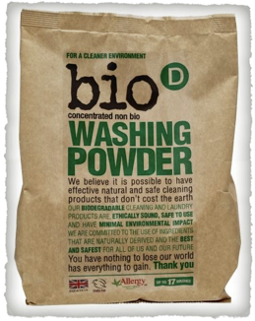
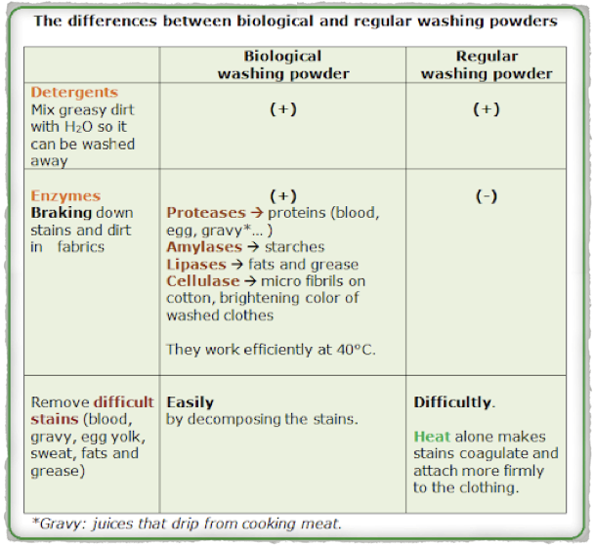
Bio. washing powder
Examples of enzymes you can find in biological washing powder are lipase, cellulase, protease, and α-amylase.
Also, enzymatic detergents can clean your clothes at lower temperatures compared to non-bios.

Slide 18
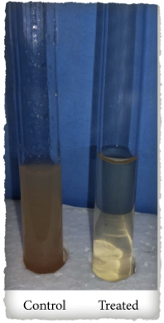
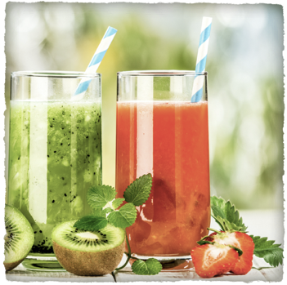
Fruit juice
Pectinase improves the yield and clarification of various fruit juices.
Pectin, a polysaccharide found in plant cell walls, is the jelly-like matrix which helps cement plant cells together and in which other cell wall components, such as cellulose fibrils, are embedded. (glue-like)
Notes:
Pectinase, commonly referred to as pectic enzymes, include pectolyase, pectozyme, and polygalacturonase, one of the most studied and widely used.
Therefore, pectinase enzymes are commonly used in processes involving the degradation of plant materials, such as speeding up the extraction of fruit juice from fruit, including apples and sapota. Pectinases have also been used in wine production since the 1960s.
The function of pectinase in brewing is twofold, first it helps break down the plant (typically fruit) material and so helps the extraction of flavours from the mash. Secondly the presence of pectin in finished wine causes a haze or slight cloudiness. Pectinase is used to break this down and so clear the wine.

Slide 19
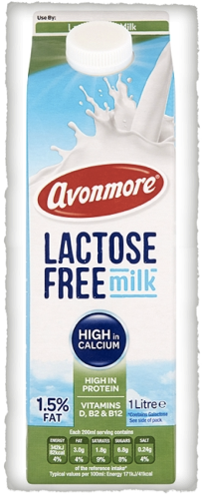
Lactose-free milk
Lactose is a type of sugar found in milk products that can be difficult for some people to digest.
Most people are born with the ability to digest lactose.
However, it’s estimated that about 75% of the global population loses this ability as they age, resulting in a condition known as lactose intolerance.
Notes:
This change typically occurs around 2–12 years of age. Some retain their ability to digest lactose into adulthood while others experience the decreased activity of lactase, the enzyme necessary for digesting and breaking down lactose.
For those with lactose intolerance, consuming regular lactose-containing milk can cause digestive issues, such as abdominal pain, bloating, diarrhea and belching

Slide 20
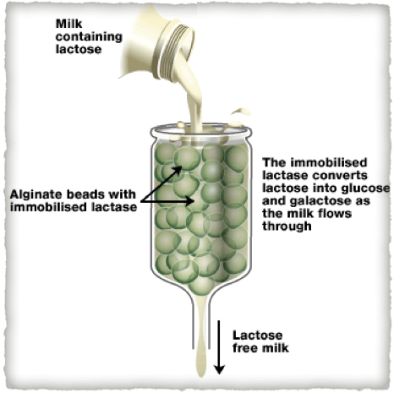
Immobilized enzymes
Immobilized enzymes are enzymes attached to an inert material.
Advantages:
Economical: continuous use of enzymes
Convenient: separation of biocatalyst and products is much easier
Stability: typically has greater thermal and operational stability than soluble form of enzymes
Notes:
Compared to free enzymes in solution, immobilized enzymes are more robust and more resistant to environmental changes.

Slide 21
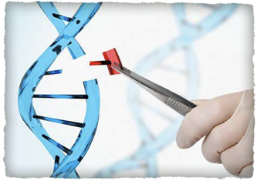
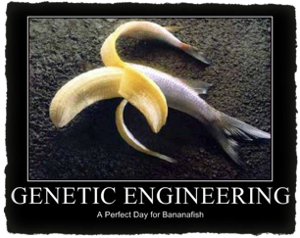
Genetic engineering
Genetic engineering, also called Genetic modification or Genetic manipulation.
Definition: Changing the genetic material of an organism by removing, changing or inserting individual genes.
Application
Human insulin: 1 human insulin gene is introduced into bacteria; 2 collect insulin after growing in huge vats.
GM (genetically modified) crops: most common traits includes 1 herbicide resistance, 2 pest resistance
e.g. glyphosate resistant soya plants, Bt cotton, golden rice (VA)

Slide 22
Genetic engineering
Steps:
1 isolate target gene from organism A using restriction enzymes
2 Cut plasmid DNA from bacterium using same restriction enzymes
3 Combine the target gene with plasmid (using ligase) to make recombinant plasmid
4 introduce the recombinant plasmid into bacteria
5 bacteria multiply and produce products. (gene is expressed)

Slide 23
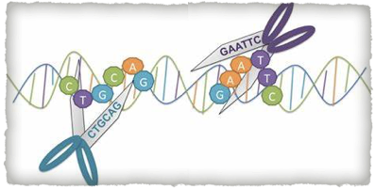


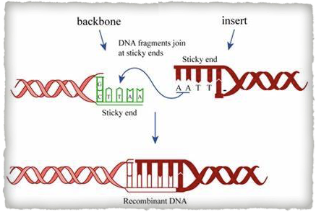
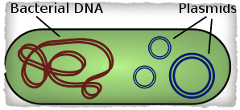
Genetic engineering - tools
Restriction enzymes - molecular scissors that cleaves DNA into fragments at or near specific recognition sites within molecules known as restriction sites.
Ligase: an enzyme that joins two fragments of DNA (glue-like)
Plasmid: a small, circular, double-stranded DNA molecules in bacteria and can replicate independently
sticky end
blunt end
Notes:
Plasmids are most commonly found as small circular, double-stranded DNA molecules in bacteria.
In nature, plasmids often carry genes that benefit the survival of the organism and confer selective advantage such as antibiotic resistance. While chromosomes are large and contain all the essential genetic information for living under normal conditions, plasmids are usually very small and contain only additional genes that may be useful in certain situations or conditions.

Slide 24
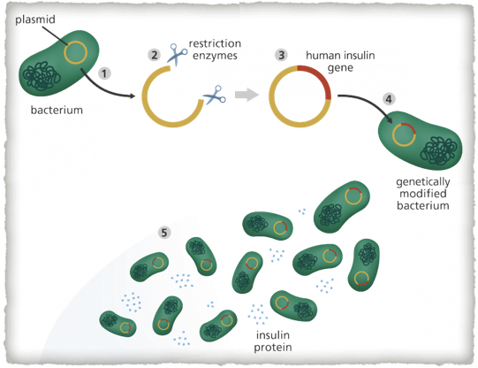
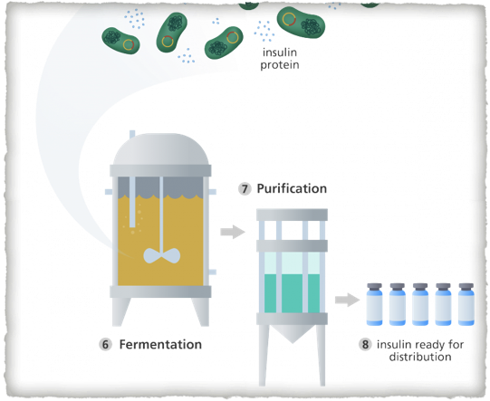
Human insulin production

Slide 25
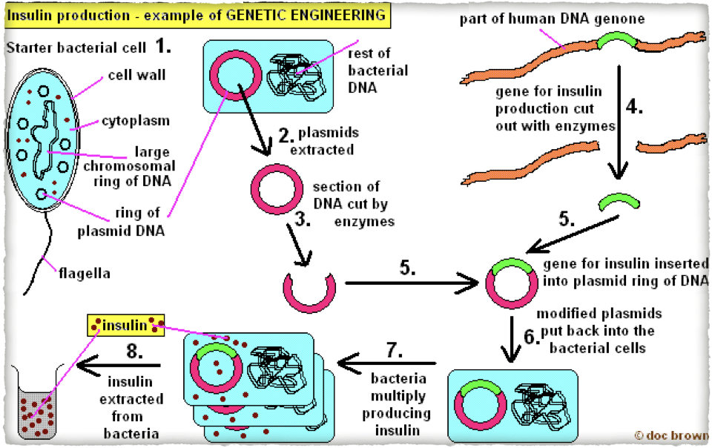
Human insulin production

Slide 26
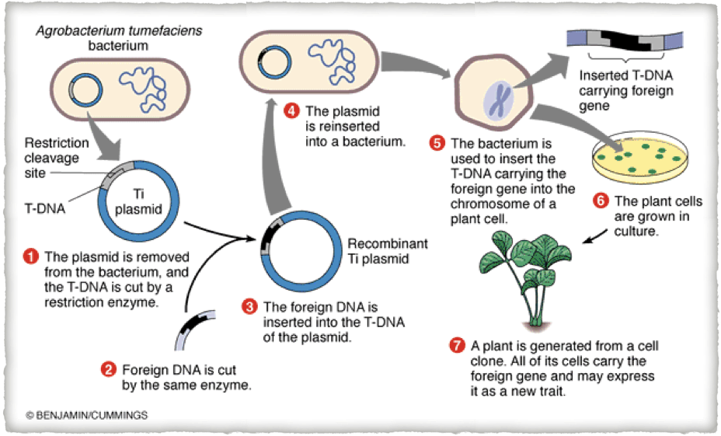
How to produce GM plants

Slide 27
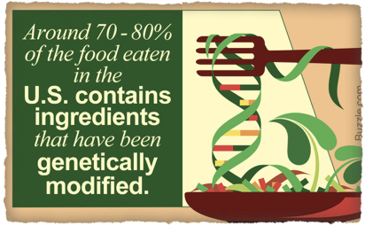
GM crops
Pros
Better traits such as better flavor, improved nutritional value, resistance to pests or herbicide or diseases or tough weather (drought, frost, salinity), faster growth
Higher yield, contribute to alleviation of poverty and hunger
less cost on herbicide or pesticide
Cons
Unpredictable and probably irreversible genetic and ecological effects
Increased selection of pesticide-resistant insects
Create herbicide-resistant weeds (gene spreads)
Harm beneficial insects

Slide 28
